Slide 1
Applied Physics EE (117)
LECTURE # 1
DATE: 19TH AUGUST , 2019

Slide 2
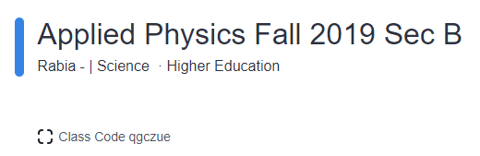
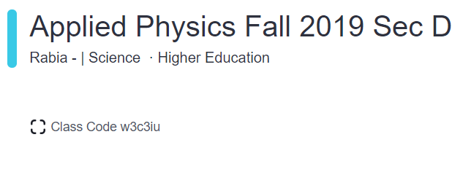


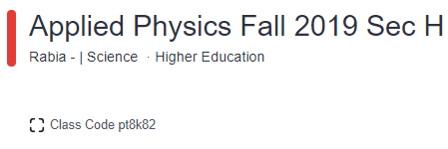
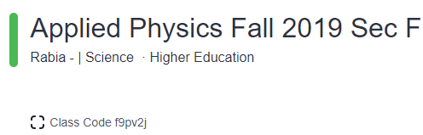


Class Code
https://www.edmodo.com

Slide 3

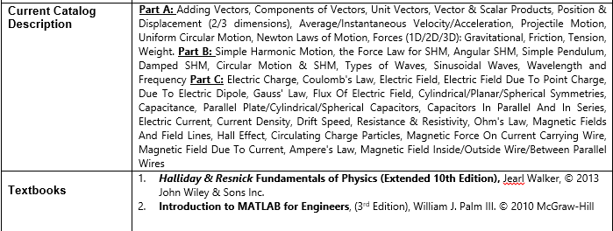
Applied Physics

Slide 4
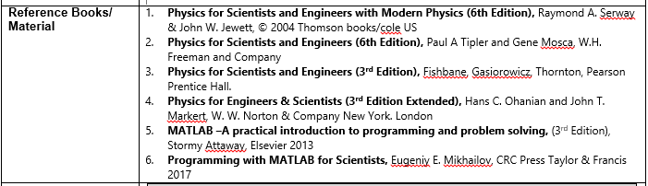
Applied Physics

Slide 5
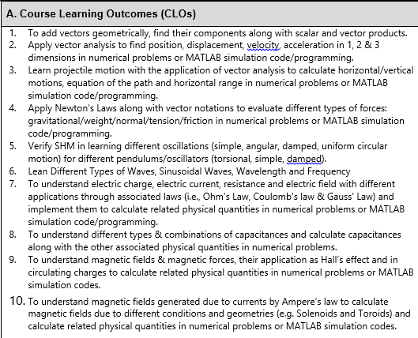
Applied Physics

Slide 6
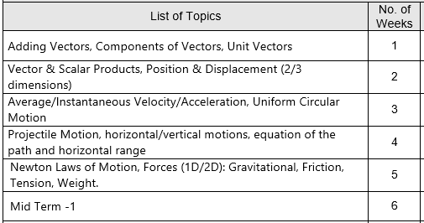
Applied Physics
Week-Wise Course Outline:

Slide 7
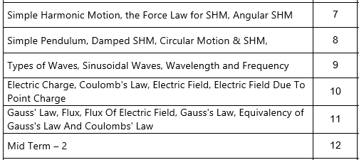
Applied Physics
Week-Wise Course Outline:

Slide 8
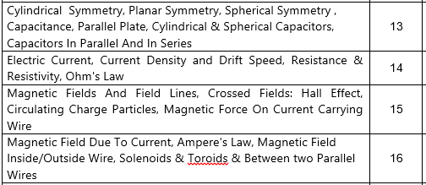
Applied Physics
Week-Wise Course Outline:

Slide 9
Applied Physics
Marks Distribution
Midterms | 30%
Class Quizzes | 10%
Assignments & Project | 10%
Final Exam | 50%
Total | 100%

